Slide 1
KISS (Keep it simple, stupid) Machine Learning
+ Machine Learning
- Calculus

Slide 2

Agenda
Introduction.
Basic Machine/Deep Learning Background.
Basic CNN Theory.
Simple Image Classifier using TensorFlow+ Keras + Python + Jupyter Notebooks.
Audience data generated Image classifier ( to be worked out)
GAN
Ending Statements.

Slide 3
Introduction
Salam,
Hello, my Name is Ali, I have come from Maryland, USA.
I was born in Bombay, India, and have lived in Dubai and Toronto, Canada.
I graduated with Molecular Biology & Biochemistry, and then
moved into Computer Programming.
I believe, we are at a new stage of learning that will transform our lives and workplaces.
I hope, that, by the end of this presentation, you will be curious enough, to explore more.

Slide 4
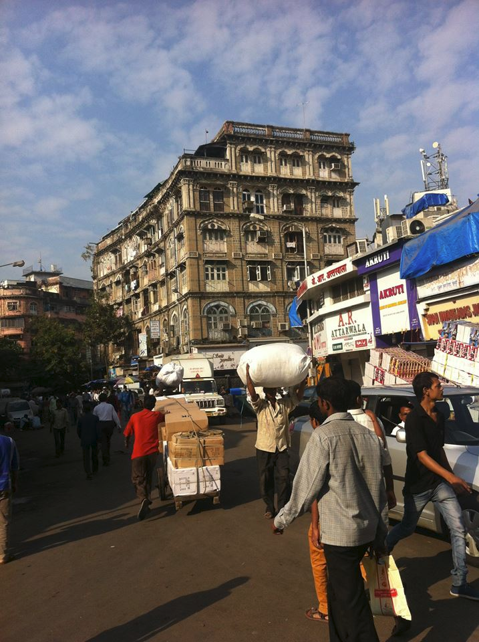
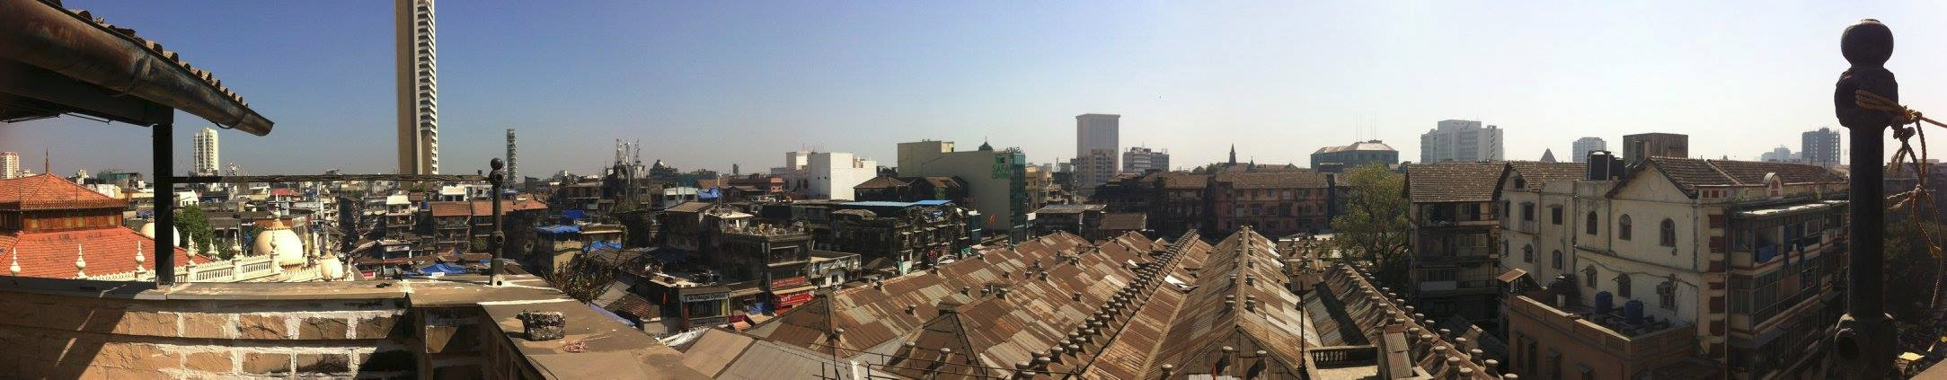
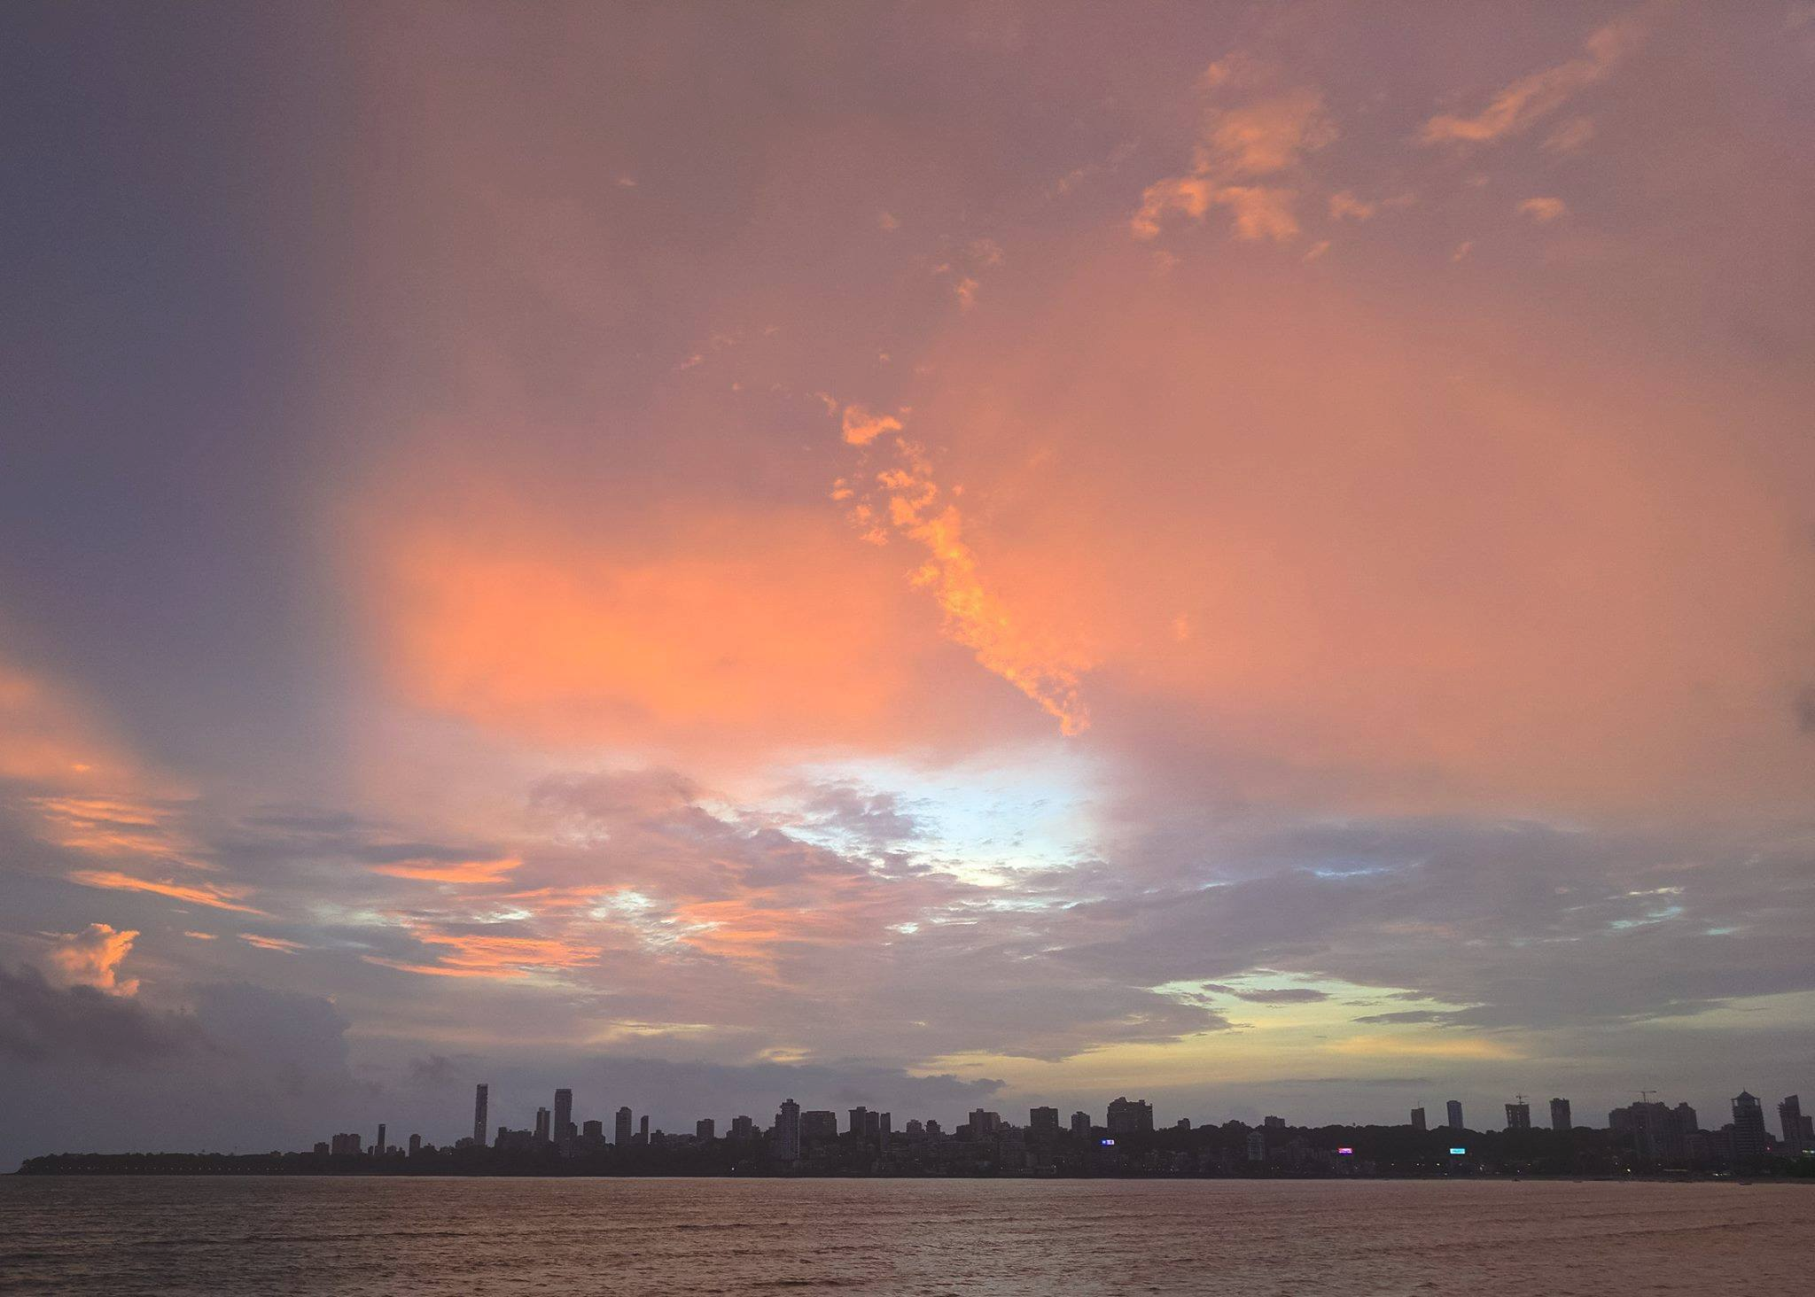
My Childhood Views

Slide 5
Basic Machine Learning Background
My friend, asked me
What will be the benefit for me if i will learn it?
In most cases people don’t want to learn, if they don’t understand how it will help them?
So if i will learn it, I can write programs which can replace jobs?
My answer is simple, its passion and curiosity and persistence that shall drive you to learn things. As we go thru the presentation, you will see how different, this is from our standard programming.
I am not here to teach you programming, or the algorithms behind them.
As Andrew Ng once said
"In addition to work ethic, learning continuously and working very hard to keep on learning is essential. One of the challenges of learning is that it has almost no short-term rewards. You can spend all weekend studying, and then on Monday your boss does not know you worked so hard. Also, you are not that much better at your job because you only studied hard for one or two days. The secret to learning is to not do it only for a weekend, but week after week for a year, or week after week for a decade. The time scale is measured in months or years, not in weeks."

Slide 6
We all can help drive discoveries
Teenagers who used Machine Learning, and made a change.
https://techcrunch.com/2017/08/03/high-schooler-makes-3d-printed-machine-learning-powered-eye-disease-diagnosis-system/
http://www.businessinsider.com/google-showcases-teen-programmer-helping-diagnose-cancer-2017-5
https://qz.com/920091/a-west-virginia-teen-taught-himself-how-to-build-a-rapping-ai-using-kanye-west-lyrics/
http://mashable.com/2017/07/28/16-year-old-ai-genius/#7RErBIInViqQ

Slide 7
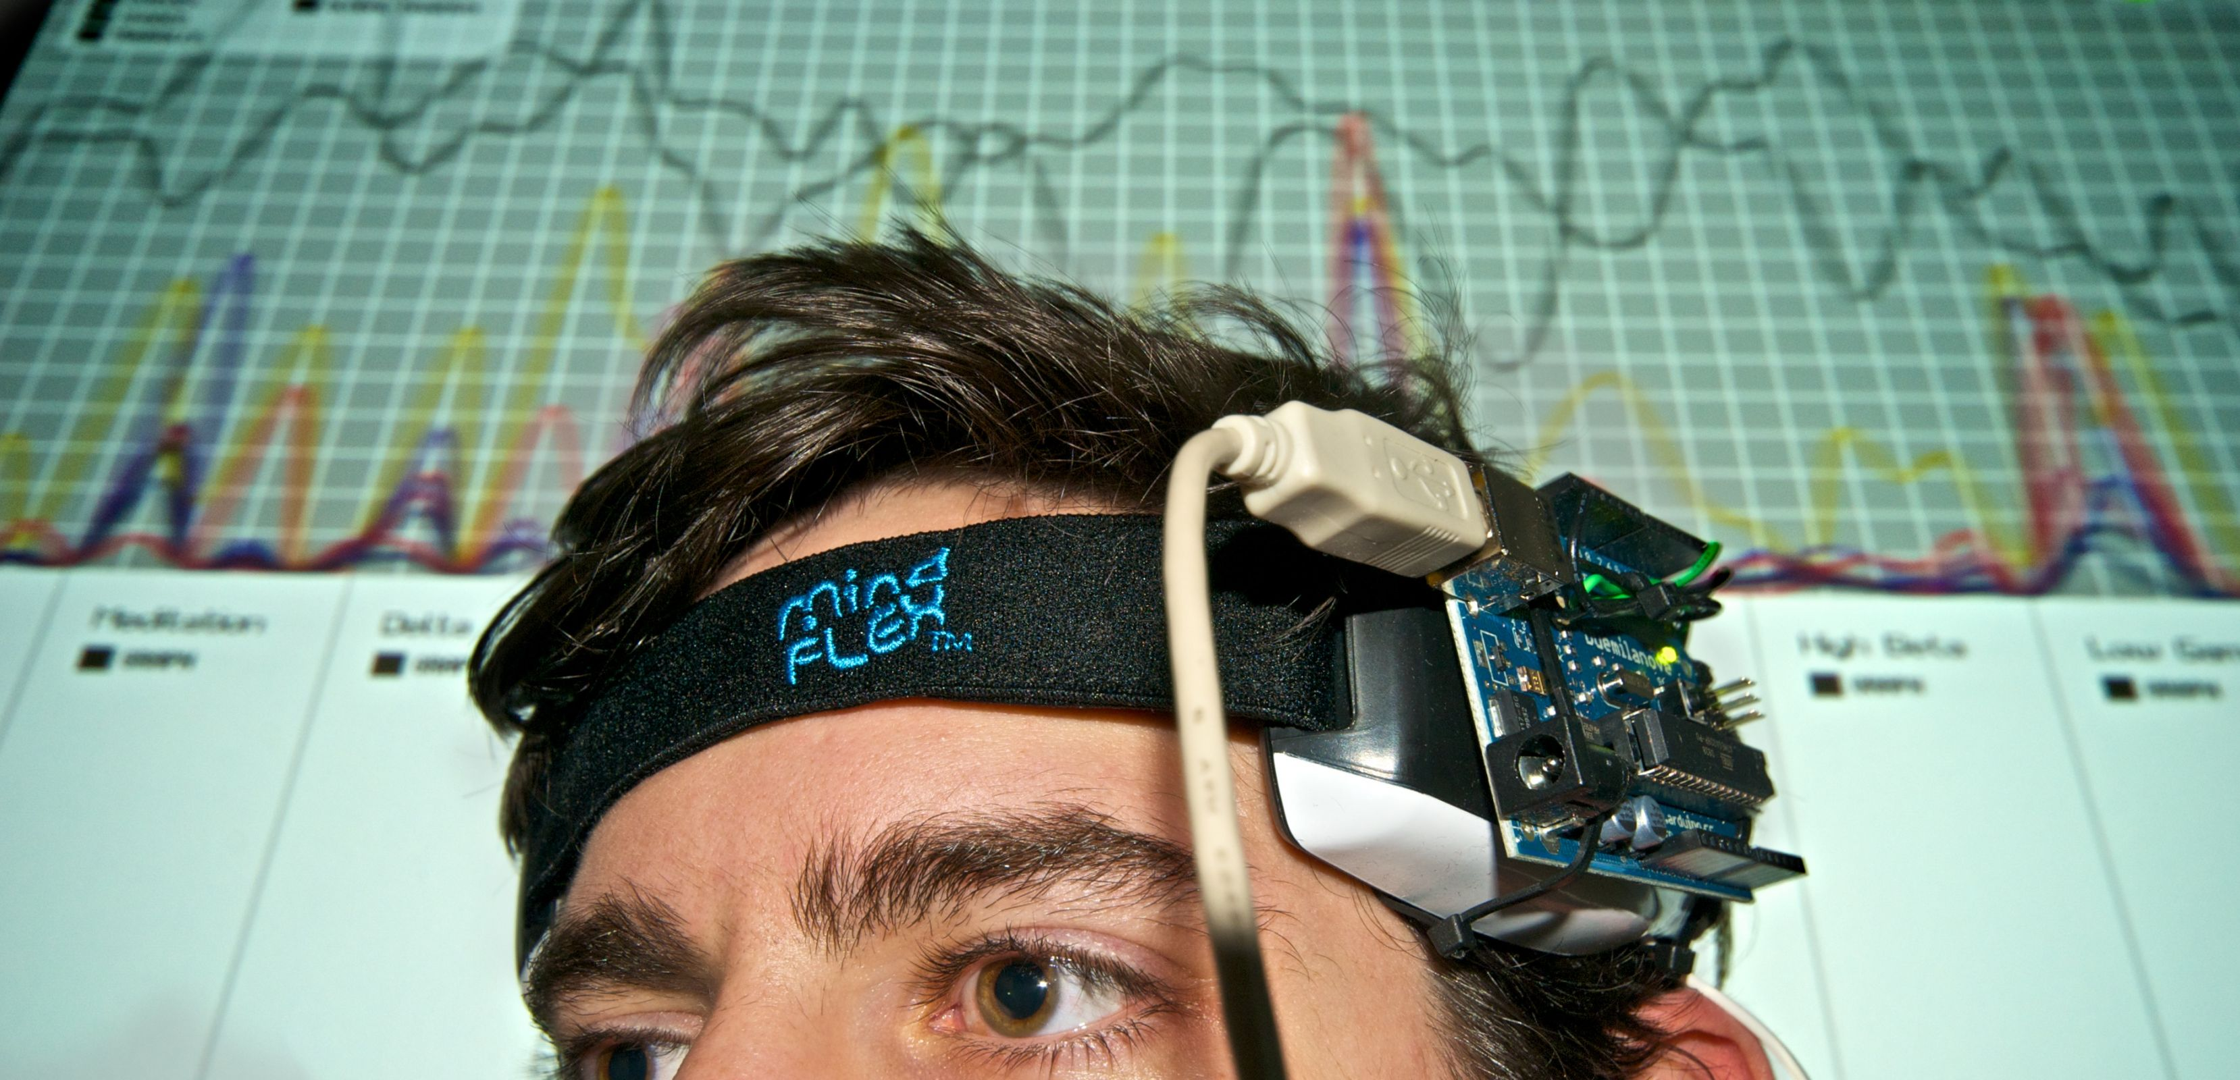
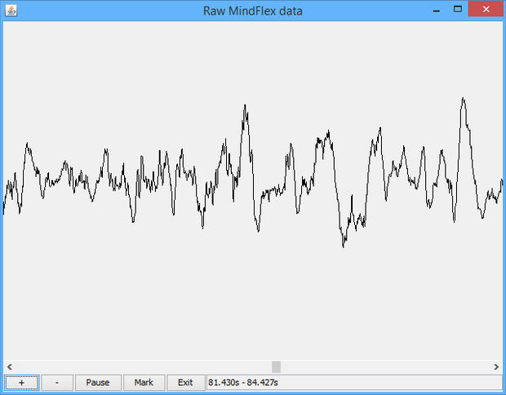
How did I get into ML
Let me tell you a story.
In College (Grade 11), I was very shy, and could never talk to a girl,
At that time I dreamt of creating an electronic pendant, that you wore around your neck, and which would turn green or red, depending on the emotions of the wearer.
The theory was, that when two persons saw each other, the pendants would change color depending on their emotions for the other person.
FastForward to a few years back. I was in the metro, dreaming of a EEG reader attached to my brain, and connected to an audrino, with two Led lights, Green and Red.
I would look at a person, with whom I was talking, capture the EEG, and via a computer program, on the audrino, use it as a lie detector.
Capture the P300 waves from my brain, and use them to tell me if that person was telling the truth or was lying. I had bought a used Mindflex from ebay.
Its not Fiction, DARPA had invented a product using this technology. They would monitor the P300 brainwave.
https://www.engadget.com/2012/09/20/darpa-cognitive-technology-threat-warning-system-ct2ws/
This is how I came into the world of machine learning, to analyze the P300 waves, and use machine learning for inference.

